Slide 1
Information Systems
Solar Car

Slide 2
Definition
An information system (IS) is any organized system for the collection, organization, storage and communication of information. More specifically, it is the study of complementary networks that people and organizations use to collect, filter, process, create and distribute data.– Wikipedia

Slide 3
Why is it important to Solar Car Racing?
Solar car racing in the culmination of thousands of decisions
Design
Three or four wheels
Hub motor or geared
Belt or chain
Type of solar cell
Etc…..
Race
Driver selection
Wait out rain or trailer ahead
Sprint and charge or run a steady pace
Speed
Charging
Etc…….
Good information allows good decisions
Good decisions are the difference between winning and losing

Slide 4
Ubiquitous sports analogy
Fourth and inches do you go for it ?
What do you want to know to help make the decision?

Slide 5
Ubiquitous sports analogy
Would it help if you knew?
Ball is on the opposition 30 yard line
Your team had 50% conversion rate
The field goal kicker is 70% from 30 yards
The opposing team has not stopped a conversion all year
Good information leads to good decisions
Notes:
Each input to the decision making was based on observations that were collected and processed. It is instinctive to know where the ball is in the field, but we need a sensor, our eyes and we need a scale, the grid lines, and a range the field for it to make sense. To know the critical statistics someone had to observe and record repeated events. They then had to analyze the events to come up with a measure that was useful in making a decision. It is entirely valid to state the field goal liker had kicked 200 field goals. That might lead to an understanding of his proficiency. It is more useful to note that he has kick 20 form 30 yards and 17 have been successful.

Slide 6
“If you know the enemy and know yourself, you need not fear the result of a hundred battles. If you know yourself but not the enemy, for every victory gained you will also suffer a defeat. If you know neither the enemy nor yourself, you will succumb in every battle.”
Sun Tzu

Slide 7
Know your enemy
How many miles does it take achieve the overall victory in the Solar Car Challenge closed track event?
We can us a simple information system to help answer the question
First we will gather a data
Second will use software to analyze the data
Third we will display the data
Finally we will use the data to make decision

Slide 8
Data
Solar Challenge Results
Year | Miles
2017 2015 | 651 789
2012 | 675
2011 | 649
2009 | 831
2008 | 657
2006 | 624
2004 | 564
2002 | 361
2000 | 381
1998 | 390

Slide 9
Analysis and Display
Statistics
In Miles
Min | 361
Max | 831
Average | 597.45
If the trend continues the winning team will run approximately 840 miles in 2019
In order to achieve 840 miles we will run an average speed of 27 mph
Notes:
I did some very simple analysis using excel. The normal statistics that you might look at are easy to pull out using formulas, but they don’t necisarily tell you much. Human as very good at picking patterns out of visual data. When we plot a graph it is very clear that the trend is towards ever increasing lap counts. That makes sense intuatuviely
However the conclusions are relatively good. You can take this information and make other decisions. We would expect that the winning car will run 27 mph every minute of the available race days. Can your car do that? What do you need to make that happen? More battery storage, more array power, more efficient design.
You can also use similar analysis to look for big jumps in teams performance. You could look at what changes they made that corresponded to that jump in performance.

Slide 10
Analysis and Display
This predicts that 710 miles would be needed to win
Or
A constant 22 mph
Notes:
I did some very simple analysis using excel. The normal statistics that you might look at are easy to pull out using formulas, but they don’t necisarily tell you much. Human as very good at picking patterns out of visual data. When we plot a graph it is very clear that the trend is towards ever increasing lap counts. That makes sense intuatuviely
However the conclusions are relatively good. You can take this information and make other decisions. We would expect that the winning car will run 27 mph every minute of the available race days. Can your car do that? What do you need to make that happen? More battery storage, more array power, more efficient design.
You can also use similar analysis to look for big jumps in teams performance. You could look at what changes they made that corresponded to that jump in performance.

Slide 11
Know yourself
By the nature of the challenge, a solar car has a limited amount of energy available.
For most solar cars, energy usage is linearly proportional to speed at slow speeds. As speed increases energy use goes up exponentially.
Two different drivers can drive the same car, on the same course and use dramatically different amounts of energy

Slide 12
Know yourself
How do you know yourself?
DRIVE!!!!!!!
Telemetry
Telemetry is a system
Choose the data you are interested in
Identify sensors to record the data
Pick a system to record the data
Process the data
Display the data
Make good decisions

Slide 13
Potential Data
Time
Temperature
Barometric Pressure
Humidity
Wind Speed
Solar Azimuth
Solar Elevation
Cloud Cover
Forecast
Location
Altitude
Speed
Acceleration
Battery Current
Motor Current
Array Current
Array Section Current
Battery Voltage
Cell Voltage
Array Voltage
Array Section Voltage
Cockpit Temperature
MPPT Temperature
MPPT Output Voltage
Battery Temperature
Motor Temperature
Controller Temperature
Tire Pressure
Tire Temperature
Brake Temperature
Shock Displacement
Shock Temperature
Throttle Position
Steering Angle
Regen Pedal Position
Brake Pedal Position
Turn signal Position
Emergency Cut Off Position
Drive Cut Off Position
Array Disconnect Position
Lap Time
Controller Data Stream
MPPT Error Code
Controller Error Code
Amp Hour Counter
Amp Hour Remaining
Amp Hours Used
Motor RPM
Bearing Temperature
Tilt
Inclination
Course
Course Inclination
Distance to turn
Time Remaining
Battery Cooling Fan
Driver Cooling Fan
Efficiency
Corner weight
Sun rise
Sun set
Driver weight
Notes:
The first step in any information system is figuring out what information you are interested in.
The is an almost infinite amount of information available. You are only limited by your budget, your computing power, and your ability to process the information. It is possible to have to little or to much information.
This is a list I came up with in about 5 minutes of the things that I would be interested in. I’ll talk about a few of them:

Slide 14
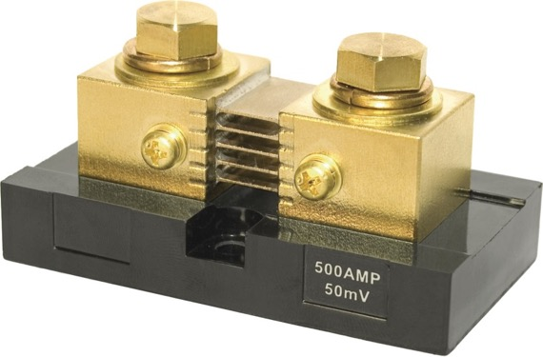
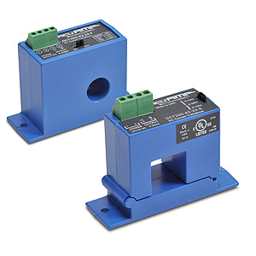
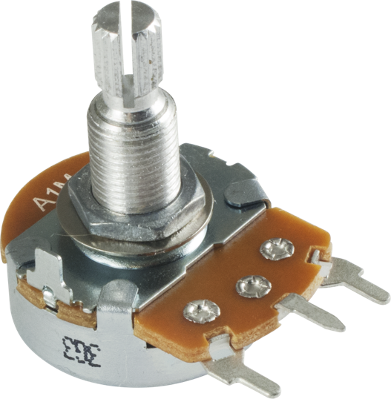
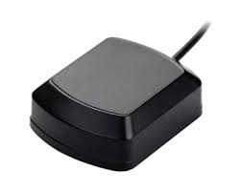
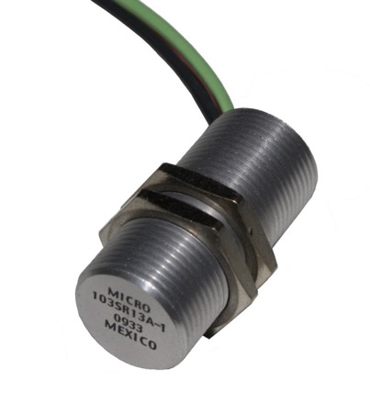
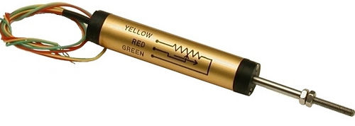
Sensors
Notes:
Once you decide what information you are interested in, you will need to determine how you are going to acquire that information. Some of the information, for example the forecast, cloud cover, or sun rise might be looked up online or retrieved from a database. However many pieces interesting of information are going to require measuring some physical property. An example of a physical property might be weight, current, or voltage. You are going to measure that property with a sensor. There are an almost infinite number and types of sensors. Every sensor has has advantages and draw backs. It is important to understand the limitation and characteristics of the sensors being used.

Slide 15
SENSOR Vocabulary
Range
Sensitivity
Resolution
Precision
Accuracy
Notes:
When dealing with a sensor, any sensor, there are some terms that you need to be familiar with. These terms help quantify how good and reliable both the sensor and the information you are getting from that sensor are.

Slide 16
Range
SENSOR Vocabulary
The interval that a sensor will provide readings within its designed parameters
Sensitivity
is an absolute quantity, the smallest absolute amount of change that can be detected by a measurement
Resolution
It is the degree to which a change can be theoretically detected, or displayed.
Notes:
Range: Every sensor has a range. It is the operating envelop of that sensor. If you operate outside the range of the sensor you may damage the sensor or the data acquisition system. You also have no idea if the information presented is accurate.
Sensitivity: a physical property of the sensor that limits how small of a change in the quantity monitored that can be detected. As sensor with a sensitivity of 1 volt can not measure a change of .1 volts. A 1 volt sensitivity may be fine if you are measuring a 10,000 volt dc power system, but is not good enough to monitor the health of the lithium ion battery where .1 volt can be the difference between fully charged and on fire.
Resolution: related to sensitivity and often used interchangeably. The difference is resolution is not necessarily a physical property. It is most accurately used when referring to the entire system that a supports a sensor. It might be limited by the display, the power supply, or sampling frequency. Most commonly it is used in a function of analog to digital converters that convert analog measurements to digital values. An 8 bit system must divide a range into 256 equal size sections. For example if your sensor has a 200 volt range. You are limited to a resolution of .78125 volts. If you upgrade to a 16 bit adc the same system now has a .00305 volt resolution

Slide 17
Precision
SENSOR Vocabulary
describes the reproducibility of the measurement.
Accuracy
the amount of uncertainty in a measurement with respect to an absolute standard
Notes:
The most important information about any sensor. The easiest way to understand precision and accuracy is to think of a target. If you take 10 shots at a target, precision is how close together your shots are, accuracy is how close to the center the shots are. The two qualities are independent.

Slide 18
Accuracy VS PRECISION
Low accuracy, Low precision
High accuracy, Low precision
High accuracy, High precision
Low accuracy, High precision

Slide 19
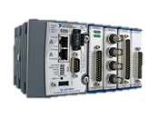
Data Loggers

Slide 20
Data Loggers
Commercial
Designed and engineered to work as a system
May limit options for sensor
Cost
DIY
Requires design
Questionable quality
Scalable
Notes:
Once you have decided what information you are interested in collecting, and how you are going to measure that information, you need a system to collect the sensor readings.

Slide 21
Data Loggers
Consideration
Analog v/s Digital signals
Analog to Digital Conversion
Communications protocols
Number of channels
How do you get the information to the user

Slide 22
Data Processing
Provide clear concise information that the user can evaluate quickly and accurately to make informed decisions

Slide 23
The Problem With RAW DATA
d90e5bc9f95dc7eb, Sat Jul 23 15:24:22 CDT 2016, 44.30015, -93.95617166666668, 259.3, REQUIRED TRAILERING, Cristian Almendariz, 8 Walnut, 31.4, 19.009722, 353.75 d90e5bc9f95dc7eb, Sat Jul 23 15:24:32 CDT 2016, 44.30194166666667, -93.95646166666666, 251.8, REQUIRED TRAILERING, Cristian Almendariz, 8 Walnut, 33.1, 20.149317, 352.67 d90e5bc9f95dc7eb, Sat Jul 23 15:24:42 CDT 2016, 44.303853333333336, -93.95695333333333, 244.5, REQUIRED TRAILERING, Cristian Almendariz, 8 Walnut, 35.9, 22.167542, 343.39 d90e5bc9f95dc7eb, Sat Jul 23 15:24:52 CDT 2016, 44.30573666666666, -93.95811666666665, 237.8, REQUIRED TRAILERING, Cristian Almendariz, 8 Walnut, 37.2, 23.086836, 331.04 d90e5bc9f95dc7eb, Sat Jul 23 15:25:02 CDT 2016, 44.307280000000006, -93.95971999999999, 231.4, REQUIRED TRAILERING, Cristian Almendariz, 8 Walnut, 32.1, 19.793129, 321.64 d90e5bc9f95dc7eb, Sat Jul 23 15:25:12 CDT 2016, 44.308551666666666, -93.96116666666667, 231.9, REQUIRED TRAILERING, Cristian Almendariz, 8 Walnut, 28.3, 17.517027, 321.7 d90e5bc9f95dc7eb, Sat Jul 23 15:25:22 CDT 2016, 44.309868333333334, -93.96240000000002, 234.9, REQUIRED TRAILERING, Cristian Almendariz, 8 Walnut, 28.0, 17.412024, 332.47 d90e5bc9f95dc7eb, Sat Jul 23 15:25:32 CDT 2016, 44.311285, -93.96335333333333, 236.6, REQUIRED TRAILERING, Cristian Almendariz, 8 Walnut, 27.8, 17.415112, 334.55 d90e5bc9f95dc7eb, Sat Jul 23 15:25:42 CDT 2016, 44.312630000000006, -93.96423166666666, 237.9, REQUIRED TRAILERING, Cristian Almendariz, 8 Walnut, 25.4, 15.826164, 334.6 d90e5bc9f95dc7eb, Sat Jul 23 15:25:52 CDT 2016, 44.31361333333333, -93.96510166666667, 240.4, REQUIRED TRAILERING, Cristian Almendariz, 8 Walnut, 13.7, 7.9689293, 310.96 d90e5bc9f95dc7eb, Sat Jul 23 15:26:02 CDT 2016, 44.313736666666664, -93.96533166666669, 240.6, REQUIRED TRAILERING, Cristian Almendariz, 8 Walnut, 4.1, 0.0, 307.71 d90e5bc9f95dc7eb, Sat Jul 23 15:26:12 CDT 2016, 44.313781666666664, -93.96542666666667, 241.3, REQUIRED TRAILERING, Cristian Almendariz, 8 Walnut, 7.3, 3.847034, 310.16 d90e5bc9f95dc7eb, Sat Jul 23 15:26:22 CDT 2016, 44.314184999999995, -93.96534166666667, 243.2, REQUIRED TRAILERING, Cristian Almendariz, 8 Walnut, 15.9, 9.325223, 26.7 d90e5bc9f95dc7eb, Sat Jul 23 15:26:32 CDT 2016, 44.315196666666665, -93.96469, 245.4, REQUIRED TRAILERING, Cristian Almendariz, 8 Walnut, 24.9, 14.556344, 24.34 d90e5bc9f95dc7eb, Sat Jul 23 15:26:42 CDT 2016, 44.31632, -93.96401499999999, 248.6, REQUIRED TRAILERING, Cristian Almendariz, 8 Walnut, 20.5, 11.182341, 15.46 d90e5bc9f95dc7eb, Sat Jul 23 15:26:52 CDT 2016, 44.317350000000005, -93.96287666666667, 239.9, REQUIRED TRAILERING, Cristian Almendariz, 8 Walnut, 25.1, 14.613479, 34.02 d90e5bc9f95dc7eb, Sat Jul 23 15:27:02 CDT 2016, 44.318374999999996, -93.96199999999999, 238.5, REQUIRED TRAILERING, Cristian Almendariz, 8 Walnut, 24.5, 14.561492, 29.92 d90e5bc9f95dc7eb, Sat Jul 23 15:27:12 CDT 2016, 44.31947166666667, -93.96110666666667, 248.3, REQUIRED TRAILERING, Cristian Almendariz, 8 Walnut, 23.3, 13.310202, 29.48 d90e5bc9f95dc7eb, Sat Jul 23 15:27:22 CDT 2016, 44.32052, -93.96021999999999, 253.1, REQUIRED TRAILERING, Cristian Almendariz, 8 Walnut, 21.4, 12.623048, 29.44 d90e5bc9f95dc7eb, Sat Jul 23 15:27:32 CDT 2016, 44.321270000000005, -93.959525, 249.1, REQUIRED TRAILERING, Cristian Almendariz, 8 Walnut, 17.9, 10.422095, 31.2 d90e5bc9f95dc7eb, Sat Jul 23 15:27:42 CDT 2016, 44.322044999999996, -93.95885000000001, 246.5, REQUIRED TRAILERING, Cristian Almendariz, 8 Walnut, 16.2, 9.33037, 30.13 d90e5bc9f95dc7eb, Sat Jul 23 15:27:52 CDT 2016, 44.32271166666666, -93.95830333333333, 246.2, REQUIRED TRAILERING, Cristian Almendariz, 8 Walnut, 15.1, 8.5891695, 33.41 d90e5bc9f95dc7eb, Sat Jul 23 15:28:02 CDT 2016, 44.32344666666666, -93.95777666666666, 252.4, REQUIRED TRAILERING, Cristian Almendariz, 8 Walnut, 15.6, 8.695203, 29.69 d90e5bc9f95dc7eb, Sat Jul 23 15:28:12 CDT 2016, 44.324063333333335, -93.95722666666667, 253.0, REQUIRED TRAILERING, Cristian Almendariz, 8 Walnut, 17.5, 10.068481, 31.85 d90e5bc9f95dc7eb, Sat Jul 23 15:28:22 CDT 2016, 44.32474833333334, -93.956635, 254.5, REQUIRED TRAILERING, Cristian Almendariz, 8 Walnut, 14.8, 8.229894, 32.1 d90e5bc9f95dc7eb,
Notes:
Now you get to the data. This is an example of raw data. This is a portion of the output from the data acquisition system the staff used to judge the 2016 race. The sensor was a gps module running on the android operating system on a generic tablet. Everything is now perfectly clear right. We can see this is Walnuts race, Cristian Almendariz was the judge we have some times and some GPS positions in there. There is lots of good information in this snippet of information, but because it is not processed we are not able to access the information.

Slide 24
Formatting
d90e5bc9f95dc7eb, Sat Jul 23 15:24:22 CDT 2016, 44.30015, -93.95617166666668, 259.3, REQUIRED TRAILERING, Cristian Almendariz, 8 Walnut, 31.4, 19.009722, 353.75
d90e5bc9f95dc7eb, Sat Jul 23 15:24:32 CDT 2016, 44.30194166666667, -93.95646166666666, 251.8, REQUIRED TRAILERING, Cristian Almendariz, 8 Walnut, 33.1, 20.149317, 352.67
d90e5bc9f95dc7eb, Sat Jul 23 15:24:42 CDT 2016, 44.303853333333336, -93.95695333333333, 244.5, REQUIRED TRAILERING, Cristian Almendariz, 8 Walnut, 35.9, 22.167542, 343.39
d90e5bc9f95dc7eb, Sat Jul 23 15:24:52 CDT 2016, 44.30573666666666, -93.95811666666665, 237.8, REQUIRED TRAILERING, Cristian Almendariz, 8 Walnut, 37.2, 23.086836, 331.04
d90e5bc9f95dc7eb, Sat Jul 23 15:25:02 CDT 2016, 44.307280000000006, -93.95971999999999, 231.4, REQUIRED TRAILERING, Cristian Almendariz, 8 Walnut, 32.1, 19.793129, 321.64
d90e5bc9f95dc7eb, Sat Jul 23 15:25:12 CDT 2016, 44.308551666666666, -93.96116666666667, 231.9, REQUIRED TRAILERING, Cristian Almendariz, 8 Walnut, 28.3, 17.517027, 321.7
d90e5bc9f95dc7eb, Sat Jul 23 15:25:22 CDT 2016, 44.309868333333334, -93.96240000000002, 234.9, REQUIRED TRAILERING, Cristian Almendariz, 8 Walnut, 28.0, 17.412024, 332.47
d90e5bc9f95dc7eb, Sat Jul 23 15:25:32 CDT 2016, 44.311285, -93.96335333333333, 236.6, REQUIRED TRAILERING, Cristian Almendariz, 8 Walnut, 27.8, 17.415112, 334.55
d90e5bc9f95dc7eb, Sat Jul 23 15:25:42 CDT 2016, 44.312630000000006, -93.96423166666666, 237.9, REQUIRED TRAILERING, Cristian Almendariz, 8 Walnut, 25.4, 15.826164, 334.6
d90e5bc9f95dc7eb, Sat Jul 23 15:25:52 CDT 2016, 44.31361333333333, -93.96510166666667, 240.4, REQUIRED TRAILERING, Cristian Almendariz, 8 Walnut, 13.7, 7.9689293, 310.96
d90e5bc9f95dc7eb, Sat Jul 23 15:26:02 CDT 2016, 44.313736666666664, -93.96533166666669, 240.6, REQUIRED TRAILERING, Cristian Almendariz, 8 Walnut, 4.1, 0.0, 307.71
d90e5bc9f95dc7eb, Sat Jul 23 15:26:12 CDT 2016, 44.313781666666664, -93.96542666666667, 241.3, REQUIRED TRAILERING, Cristian Almendariz, 8 Walnut, 7.3, 3.847034, 310.16
d90e5bc9f95dc7eb, Sat Jul 23 15:26:22 CDT 2016, 44.314184999999995, -93.96534166666667, 243.2, REQUIRED TRAILERING, Cristian Almendariz, 8 Walnut, 15.9, 9.325223, 26.7 d90e5bc9f95dc7eb, Sat Jul 23 15:26:32 CDT 2016, 44.315196666666665, -93.96469, 245.4, REQUIRED TRAILERING, Cristian Almendariz, 8 Walnut, 24.9, 14.556344, 24.34
d90e5bc9f95dc7eb, Sat Jul 23 15:26:42 CDT 2016, 44.31632, -93.96401499999999, 248.6, REQUIRED TRAILERING, Cristian Almendariz, 8 Walnut, 20.5, 11.182341, 15.46
d90e5bc9f95dc7eb, Sat Jul 23 15:26:52 CDT 2016, 44.317350000000005, -93.96287666666667, 239.9, REQUIRED TRAILERING, Cristian Almendariz, 8 Walnut, 25.1, 14.613479, 34.02
d90e5bc9f95dc7eb, Sat Jul 23 15:27:02 CDT 2016, 44.318374999999996, -93.96199999999999, 238.5, REQUIRED TRAILERING, Cristian Almendariz, 8 Walnut, 24.5, 14.561492, 29.92
d90e5bc9f95dc7eb, Sat Jul 23 15:27:12 CDT 2016, 44.31947166666667, -93.96110666666667, 248.3, REQUIRED TRAILERING, Cristian Almendariz, 8 Walnut, 23.3, 13.310202, 29.48
d90e5bc9f95dc7eb, Sat Jul 23 15:27:22 CDT 2016, 44.32052, -93.96021999999999, 253.1, REQUIRED TRAILERING, Cristian Almendariz, 8 Walnut, 21.4, 12.623048, 29.44
d90e5bc9f95dc7eb, Sat Jul 23 15:27:32 CDT 2016, 44.321270000000005, -93.959525, 249.1, REQUIRED TRAILERING, Cristian Almendariz, 8 Walnut, 17.9, 10.422095, 31.2
d90e5bc9f95dc7eb, Sat Jul 23 15:27:42 CDT 2016, 44.322044999999996, -93.95885000000001, 246.5, REQUIRED TRAILERING, Cristian Almendariz, 8 Walnut, 16.2, 9.33037, 30.13
d90e5bc9f95dc7eb, Sat Jul 23 15:27:52 CDT 2016, 44.32271166666666, -93.95830333333333, 246.2, REQUIRED TRAILERING, Cristian Almendariz, 8 Walnut, 15.1, 8.5891695, 33.41
d90e5bc9f95dc7eb, Sat Jul 23 15:28:02 CDT 2016, 44.32344666666666, -93.95777666666666, 252.4, REQUIRED TRAILERING, Cristian Almendariz, 8 Walnut, 15.6, 8.695203, 29.69
d90e5bc9f95dc7eb, Sat Jul 23 15:28:12 CDT 2016, 44.324063333333335, -93.95722666666667, 253.0, REQUIRED TRAILERING, Cristian Almendariz, 8 Walnut, 17.5, 10.068481, 31.85
d90e5bc9f95dc7eb, Sat Jul 23 15:28:22 CDT 2016, 44.32474833333334, -93.956635, 254.5, REQUIRED TRAILERING, Cristian Almendariz, 8 Walnut, 14.8, 8.229894, 32.
Notes:
Better

Slide 25
Formatting
Team | Date Time | LAT | LONG | Status | Judge | Speed | Heading
8 Walnut | Sat Jul 23 15:24:22 CDT 2016 | 44.30015 | -93.95617167 | REQUIRED TRAILERING | Cristian Almendariz | 19.009722 | 353.75
8 Walnut | Sat Jul 23 15:24:32 CDT 2016 | 44.30194167 | -93.95646167 | REQUIRED TRAILERING | Cristian Almendariz | 20.149317 | 352.67
8 Walnut | Sat Jul 23 15:24:42 CDT 2016 | 44.30385333 | -93.95695333 | REQUIRED TRAILERING | Cristian Almendariz | 22.167542 | 343.39
8 Walnut | Sat Jul 23 15:24:52 CDT 2016 | 44.30573667 | -93.95811667 | REQUIRED TRAILERING | Cristian Almendariz | 23.086836 | 331.04
8 Walnut | Sat Jul 23 15:25:02 CDT 2016 | 44.30728 | -93.95972 | REQUIRED TRAILERING | Cristian Almendariz | 19.793129 | 321.64
8 Walnut | Sat Jul 23 15:25:12 CDT 2016 | 44.30855167 | -93.96116667 | REQUIRED TRAILERING | Cristian Almendariz | 17.517027 | 321.7
8 Walnut | Sat Jul 23 15:25:22 CDT 2016 | 44.30986833 | -93.9624 | REQUIRED TRAILERING | Cristian Almendariz | 17.412024 | 332.47
8 Walnut | Sat Jul 23 15:25:32 CDT 2016 | 44.311285 | -93.96335333 | REQUIRED TRAILERING | Cristian Almendariz | 17.415112 | 334.55
8 Walnut | Sat Jul 23 15:25:42 CDT 2016 | 44.31263 | -93.96423167 | REQUIRED TRAILERING | Cristian Almendariz | 15.826164 | 334.6
8 Walnut | Sat Jul 23 15:25:52 CDT 2016 | 44.31361333 | -93.96510167 | REQUIRED TRAILERING | Cristian Almendariz | 7.9689293 | 310.96
8 Walnut | Sat Jul 23 15:26:02 CDT 2016 | 44.31373667 | -93.96533167 | REQUIRED TRAILERING | Cristian Almendariz | 0 | 307.71
8 Walnut | Sat Jul 23 15:26:12 CDT 2016 | 44.31378167 | -93.96542667 | REQUIRED TRAILERING | Cristian Almendariz | 3.847034 | 310.16
8 Walnut | Sat Jul 23 15:26:22 CDT 2016 | 44.314185 | -93.96534167 | REQUIRED TRAILERING | Cristian Almendariz | 9.325223 | 26.7
8 Walnut | Sat Jul 23 15:26:32 CDT 2016 | 44.31519667 | -93.96469 | REQUIRED TRAILERING | Cristian Almendariz | 14.556344 | 24.34
8 Walnut | Sat Jul 23 15:26:42 CDT 2016 | 44.31632 | -93.964015 | REQUIRED TRAILERING | Cristian Almendariz | 11.182341 | 15.46
8 Walnut | Sat Jul 23 15:26:52 CDT 2016 | 44.31735 | -93.96287667 | REQUIRED TRAILERING | Cristian Almendariz | 14.613479 | 34.02
8 Walnut | Sat Jul 23 15:27:02 CDT 2016 | 44.318375 | -93.962 | REQUIRED TRAILERING | Cristian Almendariz | 14.561492 | 29.92
8 Walnut | Sat Jul 23 15:27:12 CDT 2016 | 44.31947167 | -93.96110667 | REQUIRED TRAILERING | Cristian Almendariz | 13.310202 | 29.48
8 Walnut | Sat Jul 23 15:27:22 CDT 2016 | 44.32052 | -93.96022 | REQUIRED TRAILERING | Cristian Almendariz | 12.623048 | 29.44
8 Walnut | Sat Jul 23 15:27:32 CDT 2016 | 44.32127 | -93.959525 | REQUIRED TRAILERING | Cristian Almendariz | 10.422095 | 31.2
8 Walnut | Sat Jul 23 15:27:42 CDT 2016 | 44.322045 | -93.95885 | REQUIRED TRAILERING | Cristian Almendariz | 9.33037 | 30.13
8 Walnut | Sat Jul 23 15:27:52 CDT 2016 | 44.32271167 | -93.95830333 | REQUIRED TRAILERING | Cristian Almendariz | 8.5891695 | 33.41
8 Walnut | Sat Jul 23 15:28:02 CDT 2016 | 44.32344667 | -93.95777667 | REQUIRED TRAILERING | Cristian Almendariz | 8.695203 | 29.69
8 Walnut | Sat Jul 23 15:28:12 CDT 2016 | 44.32406333 | -93.95722667 | REQUIRED TRAILERING | Cristian Almendariz | 10.068481 | 31.85
8 Walnut | Sat Jul 23 15:28:22 CDT 2016 | 44.32474833 | -93.956635 | REQUIRED TRAILERING | Cristian Almendariz | 8.229894 | 32
Notes:
Now you get to the data. This is an example of raw data. This is a portion of the output from the data acquisition system the staff used to judge the 2016 race. The sensor was a gps module running on the android operating system on a generic tablet. Everything is now perfectly clear right. We can see this is Walnuts race, Cristian Almendariz was the judge we have some times and some GPS positions in there. There is lots of good information in this snippet of information, but because it is not processed we are not able to access the information.

Slide 26
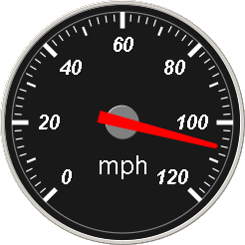
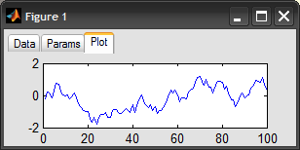
Display and visualization
Numbers
Stop light
Chart
Notes:
Text is nice. However, most people do not process large volumes of text quickly and accurately. Visualizations are a simple way to present large amounts of information quickly and concisely. For example, with the speedometer I can look at that an instantly know the cars speed. I don’t have to scan a list of information and find the most recent information and separate the speed from all the other information. Charts allow you to instantly see history, and spot trends. Stop lights can instantly call attention to important information.

Slide 27
Analysis and Decision making
Notes:
The point of the entire exercise is to present information.
Images from a Nissan Leaf’s dash.
This can be done in the car or on a computer display.
It is a convenient way to display a large amount of information
In the picture on the left you can see displays of the battery. You can also see the mileage remain, this requires processing a information previously recorded. You can make it as simple or as complex as you want.

Slide 28
What I would do
There is no right answer
If there was, this is not it
This is not endorsed by the Solar Car Challenge
This is not an endorsement of any product or company
This is what I would do, and how I thought through the problem

Slide 29
Information I want to know
Minimalist
Array Current
Motor Current
Battery Current
Aux Battery Current
Array voltage
Battery Voltage
Throttle Position
Brake/Regen Position
Speed
Advanced
Weather
Weight
Road profile
Notes:
Array Current – tells you how much current is coming in, allow to choose best angle when charging. If you see power dropping off and the atmosphere has not change it might be time to move the array.
Motor Current – How much power is being passed to the motor. It is the variable that you can change for how long the battery pack will last.
Battery Current – is equal to the Array Current – Motor Current. Having a separate reading is a good cross check to ensure all sensors are working properly and there is not a fault.
Aux Battery Current – current measuring the current used is the most accurate way to determine the power remaining in the battery. It is much more accurate then voltage. By knowing how much power is left in the battery you can make appropriate decisions about when to change the aux battery. If the battery can run longer then the driver it is to large. If it requires frequent changes it is to small.
Array voltage – combined with array current tells array health
Battery voltage – Safety
Throttle/break position – How you drive a solar car is incredibly important. By measuring the throttle and break position and comparing it to current is a good method to train drivers. It provides feedback to the team on how good a driver is.
Speed – Mostly informational. However, it is important for maintaining speed limits especially on pit road. It also can be a factor in strategy if you know you have a certain amount of time to get a given distance.

Slide 30
Sensors
Current
Hall Effect sensors
Voltage
Custom voltage divider
Pedal position
Potentiometer
Speed
GPS sensor
Notes:
Current - Hall effect sensors are more complicated, cost more, and are potentially less accurate then shunts. However shunts are a resister. I want to avoid adding unnecessary resisters. The shunt also requires adding additional connections. The hall effect sensors simply slip over the cable.
Voltage - There are plenty of off the shelf voltage sensors available. Many D/A system can monitor voltage directly. I prefer to build my own voltage dividers to ensure the range is where I want it. I also can choose a better quality analog to digital converter. Exposing the D/A system to high voltages is an easy way to damage it. By having my own boards I can add an extra layer of protection. They are also cheap and easy to build. Downside is they do have to be built and calibrated.
Pedal position – potentiometers. Cheap and easy. An extreme level of precision is not required.
Speed. GPS requires an additional sensor and processor. The system may or ay not produce speed directly. If it doesn’t you may have to calculate speed. I have had poor luck with magnetic sensors, ie bike speedometers. Optical systems could be much more precise, but are subject to issues with cleanliness. A sensor must be mounted on the wheel or hub and alignment is important.

Slide 31
?

